Slide 1
Why the detour?
Why we needed to change our Toolkit?

Slide 2
Language and Mathematics
Mathematical Enquiry into Languages revealed to us
The Art and Science of Logic
And Boolean Algebra
But so far, no enquiry has been made towards the direction concerning the relationship between
Structure of Brain- Languages - Geometry

Slide 3
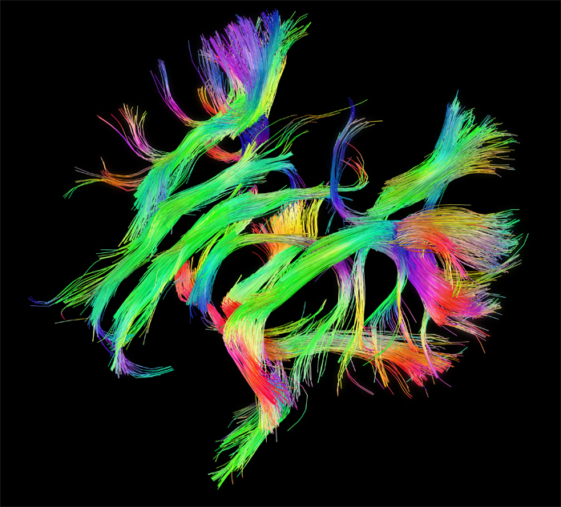
Recent Advances
Connectome
Structure of Human Brain using
Functional Magnetic Resonance
Imaging [ f-mri ]

Slide 4
Recent Advances
We have, as a knowledge curators, have gathered a tremendous amount of data regarding Languages.
And the computers have become approachable enough to process various kinds of languages with the least effort.
Suomi - Finnish
日本語 - Japanese
And birth of Man-made artificial languages!

Slide 5
Our Belief
There are unexplored Mathematical Relationships hidden within languages.
Esperanto - An Artificial Language
Highly Logical Human language

Slide 6
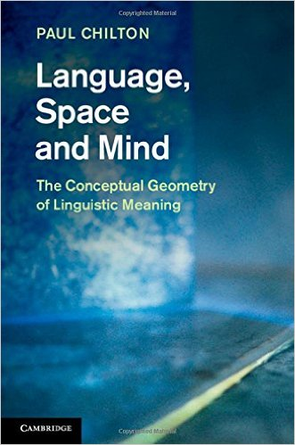
Our Real Goal!
We wish to apply the principles used in thisbook and explore those structures within the context of Mathematics and Structure of Languages.

Slide 7
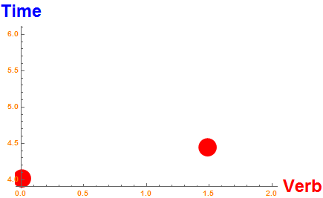
Beyond Boole?
When we plot verbs like
Estas -> Est + AS
( Present, First Person )
Estos -> Est + OS
( Future, First Person )
Eventually we hope to establish relationships like
Sentence (s) = Noun + Verbs^2 - Cases_degree

Slide 8

Mathematica
We relied Heavily on Mathematica™
for our previous two projects.
Closed Source
Costs A-Lot
Underdeveloped Language Processing
capabilities
What After College ?

Slide 9


Python
Open Source
Community Driven
Industry Strength – NLTK library
Wonderful Libraries
Free!

Slide 10
Changing the Toolkit
We wish to continue to work along these lines and see how far we can take the concept.
Thus we sincerely felt the need to Level-Up using the Real World programming tools!
Hence, we chose to use the Python Scientific Stack to gain experience with various libraries we will be using next semester.

Slide 11
Skills Gained
Now, we shall show you our Major project.
The Application of Python Libraries for Real World usage in Data Analysis and Visualizations.

